Slide 1

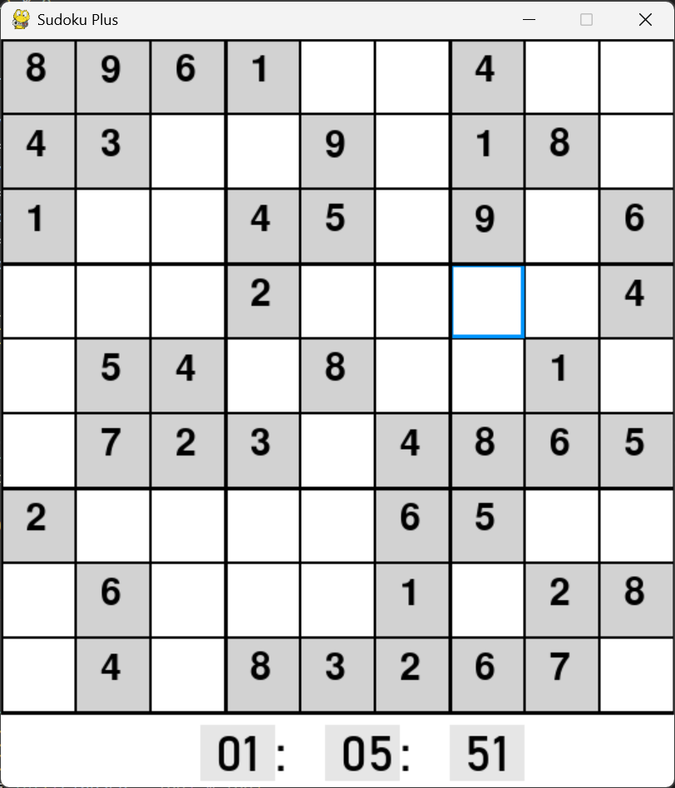
Sudoku Plus
Made by Aiden Caraway https://github.com/ksu-is/Sudoku-Plus
A fast-paced Sudoku game where the goal is to finish the puzzle as quickly as possible.

